Slide 1

Collections
The Java collection’s framework provides a large set of readily usable general-purpose data structures and algorithms.
Collection framework standardizes the way in which group of objects are handled by our program.
These data structures and algorithms can be used with any suitable data type in a type-safe manner; this is achieved through the use of a language feature known as generics.

Slide 2
collection(s)- is a generic term represents group of objects(Set or List or Map).
We use term container as an alternative name for this, to avoid confusion.
Collection – is the base interface, for all the collection related interfaces.
Collections—as in java.util.Collections—is a utility class that contains only static methods.

Slide 3
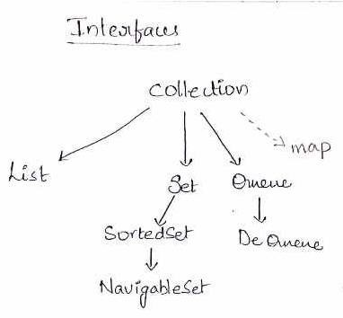

Slide 4
Collection interface
Collection - Common base interface for all the interfaces(classes) in the collection hierarchy.
Consists of methods that are common for all types of containers (List’s, Set’s and Map’s)

Slide 5
List interface
for containers that store a sequence of elements
You can insert the elements using an index, and retrieve the same element later (so that it maintains the insertion order).
You can store duplicate elements in a List.

Slide 6
Set interface
for containers that do not allow duplicate elements.
SortedSet interface -
maintains the set elements in a sorted order.
NavigableSet interface -
allows searching the set for
the closest matches.

Slide 7
Queue interface
base interface for containers that holds a sequence of elements for processing.
For example, the classes implementing Queue can be
LIFO (last in, first out—as in stack data structure) or FIFO (first in, first out—as in queue data structure).
Deque interface
you can insert or remove elements from both the ends.

Slide 8
Map interface
for containers that map keys to values.
SortedMap interface - the keys are in a sorted order.
NavigableMap interface - allows you to search and return the closest match for given search criteria.
Note :
Map hierarchy does not extend the Collection interface.
.

Slide 9
Iterable interface - A class implementing this interface can be used for iterating with a for each statement.
Iterator interface - You can traverse over the container in the forward direction if a class implements the Iterator interface.
ListIterator interface - You can traverse in both forward and reverse directions if a class implements the ListIterator interface.

Slide 10
Important Methods - Collection interface
boolean add(Element elem)
Adds elem into the underlying container.
void clear()
Removes all elements from the container.
boolean isEmpty()
Checks whether the container has any elements or not.
Iterator<Element> iterator()
Returns an Iterator<Element> object for iterating over the container.

Slide 11
boolean remove(Object obj)
Removes the element if obj is present in the container.
int size()
Returns the number of elements in the container.
Object[] toArray()
Returns an array that has all elements in the container.

Slide 12
Methods – that Apply to Multiple Elements
boolean addAll(Collection<?extends Element> c2)
Adds all the elements in c2 into the underlying container.
boolean containsAll(Collection<?> c2)
Checks if all elements given in c2 are present in the underlying container.

Slide 13
boolean removeAll(Collection<?> c2)
Removes all elements from the underlying container that are also present in c2.
boolean retainAll(Collection<?> c2)
Retains elements in the underlying container only if they are also present in c2; it removes all other elements.

Slide 14
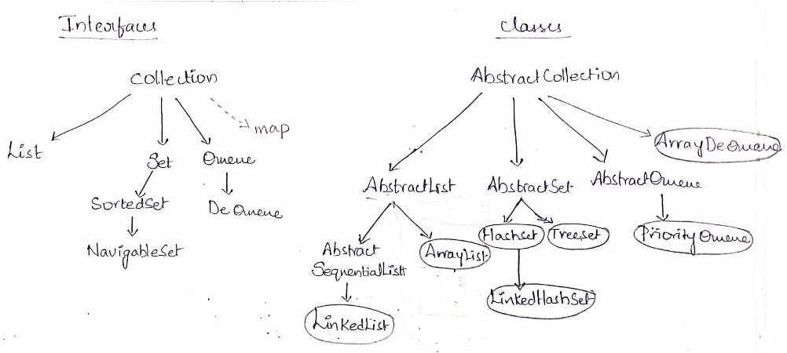

Slide 15
Concrete Classes
ArrayList
Data structure used to implement : resizable array
Searching : Fast
insert or delete : Slow
duplicates : Allows duplicates

Slide 16
LinkedList
Data structure : doubly linked list
insert or delete : Fast
Searching : Slow
Duplicates : Allows duplicates
Additionally, LinkedList can be used when you need a stack (LIFO) or queue (FIFO) or dequeue data structure.

Slide 17
HashSet
Data Structure : hash table
Uses hashing for finding a place
to search or
to store any object(element)
Used for : storing a set of elements
Duplicates : Does not allow duplicates
Searching : Very Fast
Insert or delete : Very Fast
Elements order: does not maintain any order for stored elements.

Slide 18
TreeSet
Data Structure : red-black tree
Duplicates : does not allow.
Elements order : Stores the elements in sorted order
It uses a tree data structure to decide where to store or search the elements, and the position is decided by the sorting order.

Slide 19
HashMap
Data Structure : hash-table data structure.
Used for : Storing key and value pairs.
Uses hashing for finding a place
to search or
to store a pair.
Searching : very fast.
Insertion or deletion : very fast.
Elements order : It does not store the elements in any order.

Slide 20
TreeMap
Data Structure : red-black tree.
Elements order : stores the elements in a sorted order.
It uses a tree data structure to decide where to store or search for keys, and the position is decided by the sorting order.

Slide 21
PriorityQueue
Data structure : heap data structure.
A PriorityQueue is for retrieving elements based on priority.
Irrespective of the order in which you insert, when you remove the elements, the highest priority element will be retrieved first.

